Slide 1
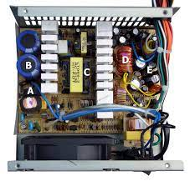
Switched mode power supply
EVENT 2
CONTROL SYSTEMS
SYNOPSIS PRESENTATION
PRESENTED BY:*ASHWIN
*RASHMI
*MANOJ

Slide 2
CONTENTS
Introduction
Objectives
Methodology
Tools and technologies used
Block diagram
Applications
Advantages and disadvantages
Conclusion
References

Slide 3
introduction
Any device that supplies electric power to any electric load is called as power supply. The different types of power supplies include : Battery ,DC power supply, AC power supply, Linear regulated power supply, Switched mode power supply, Programmable power supply, Uninterruptible power supply.
A switched-mode power supply (switching-mode power supply, switch-mode power supply, switched power supply, SMPS, or switcher) is an electronic power supply that incorporates a switching regulator to convert electrical power efficiently. Like other power supplies, an SMPS transfers power from a DC or AC source (often mains power, see AC adapter) to DC loads.
Any electrical power supply that incorporates a switching regulator to convert electrical power efficiently.
It transfers power from a source, to a load, while converting voltage and current characteristics.
Voltage regulation is achieved by varying the ratio of on to off time.

Slide 4
A switch mode power supply is a power converter that utilizes switching devices such as MOSFETs that continuously turn on and off at high frequency; and energy storage devices such as the capacitors and inductors to supply power during the non-conduction state of the switching device.
The supplies have higher efficiencies of up to 90%, are small in size and widely used in computers and other sensitive electronic equipment.
The basic switch mode power supplies (SMPS) are categorized based on supply input and output voltage. The main four groups are:
AC to DC – Off-line
DC power supply
DC to DC – Converter
DC to AC – Inverter

Slide 5
Objectives
To understand closed loop system and its fundamentals.
Develop the Model for the system.
Develop the feedback system.
Compare the proposed methods with existing works.

Slide 6
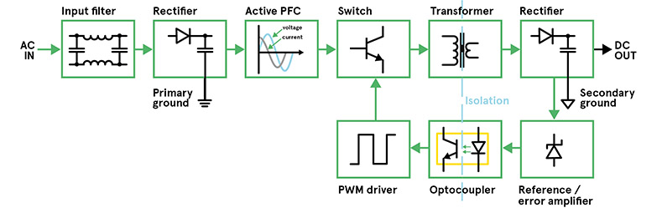
WORKING AND BLOCK DIAGRAM:
Fig.2 BLOCK DIAGRAM OF A SMPS

Slide 7
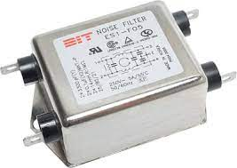
Filter
A filter is a circuit capable of passing (or amplifying) certain frequencies while attenuating other frequencies. Thus, a filter can extract important frequencies from signals that also contain undesirable or irrelevant frequencies.
Fig. 3 noise filter

Slide 8
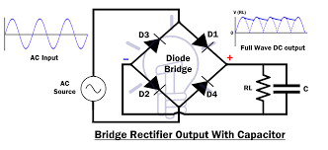
RECTIFIER
It is used to convert an ac input to dc.
A SMPS with dc input does not require this stage.
The rectifier produces unregulated dc which is then passed through the filter circuit.
Fig. 4 bridge rectifier

Slide 9
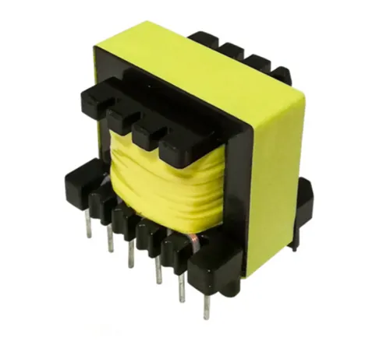
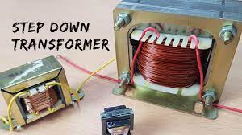
TRANSFORMER
A transformer is a device that transfers electric energy from one alternating-current circuit to one or more other circuits, either increasing (stepping up) or reducing (stepping down) the voltage. Here we use a step down transformer.
Fig 8. Ferrite Core Transformer fig 9. Iron Core Transformer

Slide 10
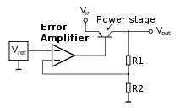
ERROR AMPLIFIER
The error amplifier compares the reference voltage (VREF) output by the reference voltage circuit and the feedback voltage (VFB) divided by the feedback resistor to control the output driver on-resistance to ensure the output voltage (VOUT) is maintained at the required voltage.
Fig. 10 representation of error amplifier

Slide 11
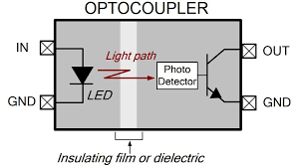
OPTOCOUPLER
One of the usual applications of optocoupler is to provide isolation between two ground reference. That is why it is often seen in power supply feedback circuit. 1.The optocoupler can form various logic circuits. Since the anti-interference performance and isolation performance of the optocoupler are better than those of the transistor, it is more reliable to form the logic circuit formed.
In the switching circuit, it is often required to have good electrical isolation between the control circuit and the switch, which is difficult for a general electronic switch, but it is easy to implement with a photocoupler.
FIG.11 OPTOCOUPLER

Slide 12
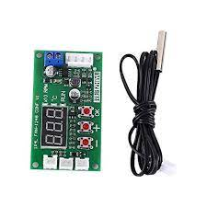
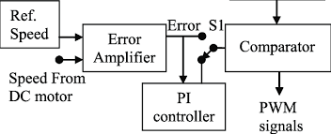
PWM DRIVER
PWM (Pulse Width Modulation) is an efficient way to vary the speed and power of electric DC motors.
As its name suggests, pulse width modulation speed control works by driving the motor with a series of “ON-OFF” pulses and varying the duty cycle, the fraction of time that the output voltage is “ON” compared to when it is “OFF”, of the pulses while keeping the frequency constant.
FIG. 12 PRACTICAL PWM DRIVER FIG.13 BLOCK DIAGRAM OF PWM DRIVER

Slide 13
METHODOLOGY:
If we design a linear power supply then it requires iron core transformers which operates at low frequency and it has many disadvantages like less efficiency, humming noise, occupy more space. So we try to implement SMPS model which operates at high frequency and they have many advantages in terms of efficiency.
To simulate this control system we are using SIMULINK software.
SIMULINK is a computer program developed by Math Works [1] for the analysis of dynamic systems . There are two important steps in running SIMULINK: model definition and model analysis. In the definition phase a graphical editor is used to set-up hierarchical block diagram models of control systems.

Slide 14
Blocks can be selected form the SIMULINK library and blocks can be nested within other blocks. Then the blocks can be wired together to establish the model of a system. In the analysis phase, the defined model can be simulated from the SIMULINK menu.
SIMULINK can use any function of MATLAB or its related toolboxes. These toolboxes include control systems, nonlinear control, robust control, optimization, system identification, neural networks, fuzzy logic, quantitative feedback theory, partial differential equations, signal processing, symbolic mathematics, and many more.
MATLAB and its toolboxes are well known and widely used by control engineers. The simulation process in SIMULINK consists of numerical integration of ordinary differential equations

Slide 15
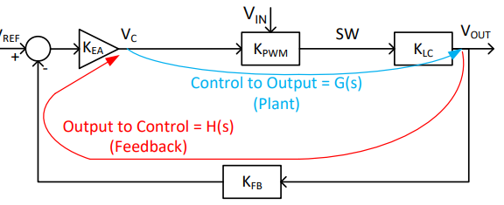
A Typical Control System
KEA(s)* Error Amplifier (transfer function as function of complex frequency)
KPWM Pulse Width Modulator (A Constant)
KLC(s) Output Filter
KFB Feedback Potential Divider
G(s) = KPWM * KLC(s) = Control to Output gain
H(s) = KFB * KEA(s) = Output to Control gain
Total loop response T(s) = G(s) * H(s)
Fig. 3 Closed loop System of smps

Slide 16
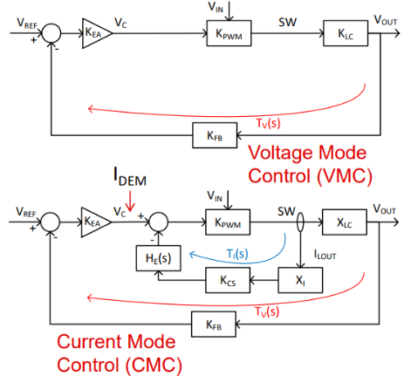
Two Control Systems: VMC and CMC
Fig. 3 noise filter
Fig. 3 VMC and CMC

Slide 17
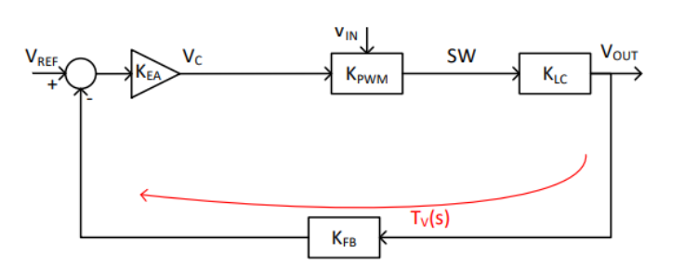
Control Systems: Voltage Mode Control
Error amplifier output VC controls D directly VOUT drops → VC increases → D increases → VOUT increases
Error Amplifier controls Duty Cycle (D) directly
Less noise sensitive than PCM – larger ramp
Easy to implement Voltage Feed Forward

Slide 18
Advantage of smpS
Lower weight
Smaller size
Higher efficiency
Lower power dissipation
Wide ac input voltage range
Reduced costs

Slide 19
Application of SMPS
Machine tool industry
Security systems (closed circuit cameras)
Support supplies with PLC’s
Personal computers
Mobile phone chargers

Slide 20
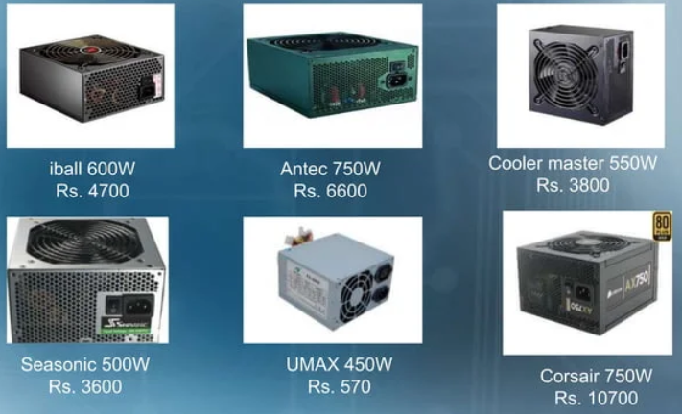
SMPS IN INDIAN MARKETS:

Slide 21
CONCLUSION
The most common SMPS topologies are flyback , push pull , half bridge and full bridge converters.
Working of a general SMPS is discussed in the above slides.
Application of SMPS is outlined.

Slide 22
REFERENCE
[1] Liao Wang 2012. MATLAB/SIMULINK. IEEE TRANSACTIONS ON EDUCATION, 55(1)
[2] The Math Works Inc., "SIMULINK, Dynamic System Simulation Software," 1994.
[3] The Math Works Inc., "SIMULINK 1.3 Release Notes," 1994.
[4] Middlebrook and Cuk (1976). A general unified approach to modeling switching converter power
stages. In the IEEE Power Electronics Specialists Conference,IEEE: 19-34.
https://doi.org/10.1109/PESC.1976.7072895
[5] Emadi A (2004). Modeling and analysis of multiconverter DC power electronic systems using the
generalized state-space averaging method. IEEE Transactions on Industrial Electronics, 51(3): 661-
668.
[6]Fundamentals of Power Supply Design: Mammano: Texas Instruments, 2017

